Slide 1
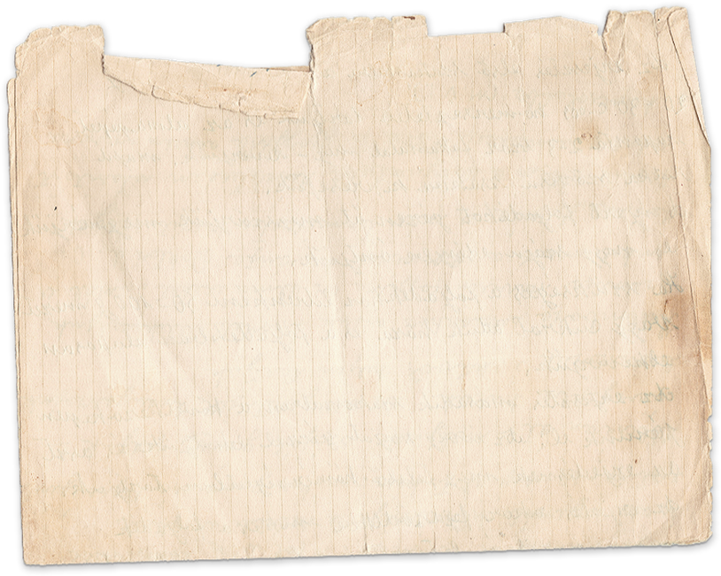
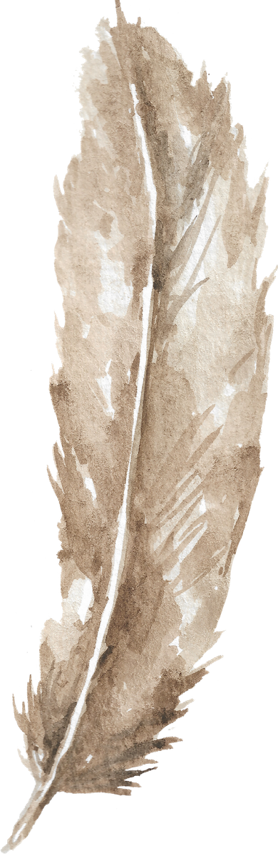

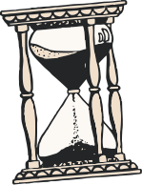
The Dangers
of Literary Censorship
Presented by Kaitlyn Johnson

Slide 3
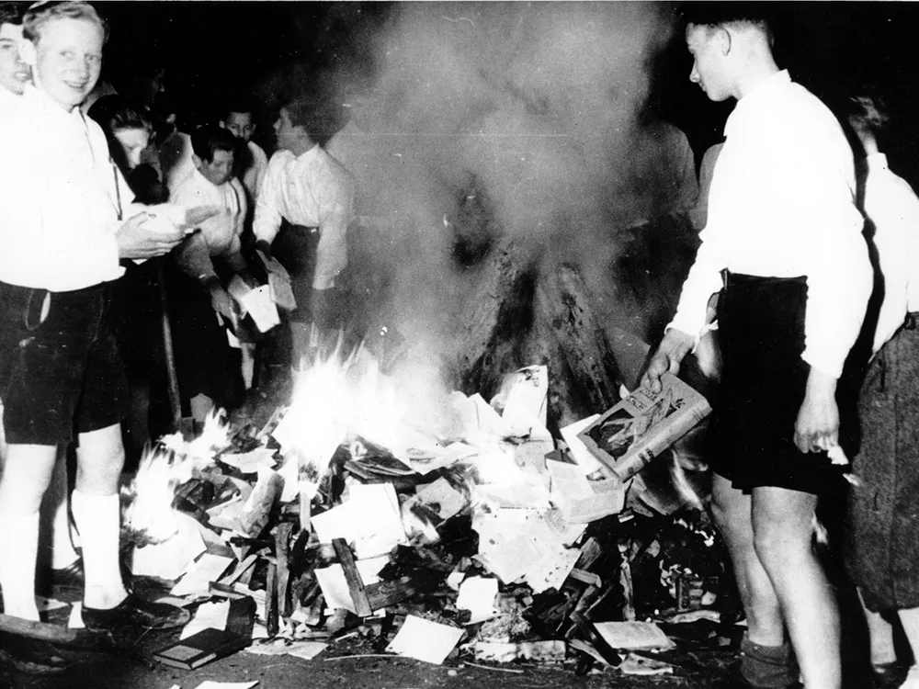
A book is a loaded gun in the house next door.
Ray Bradbury

Slide 4
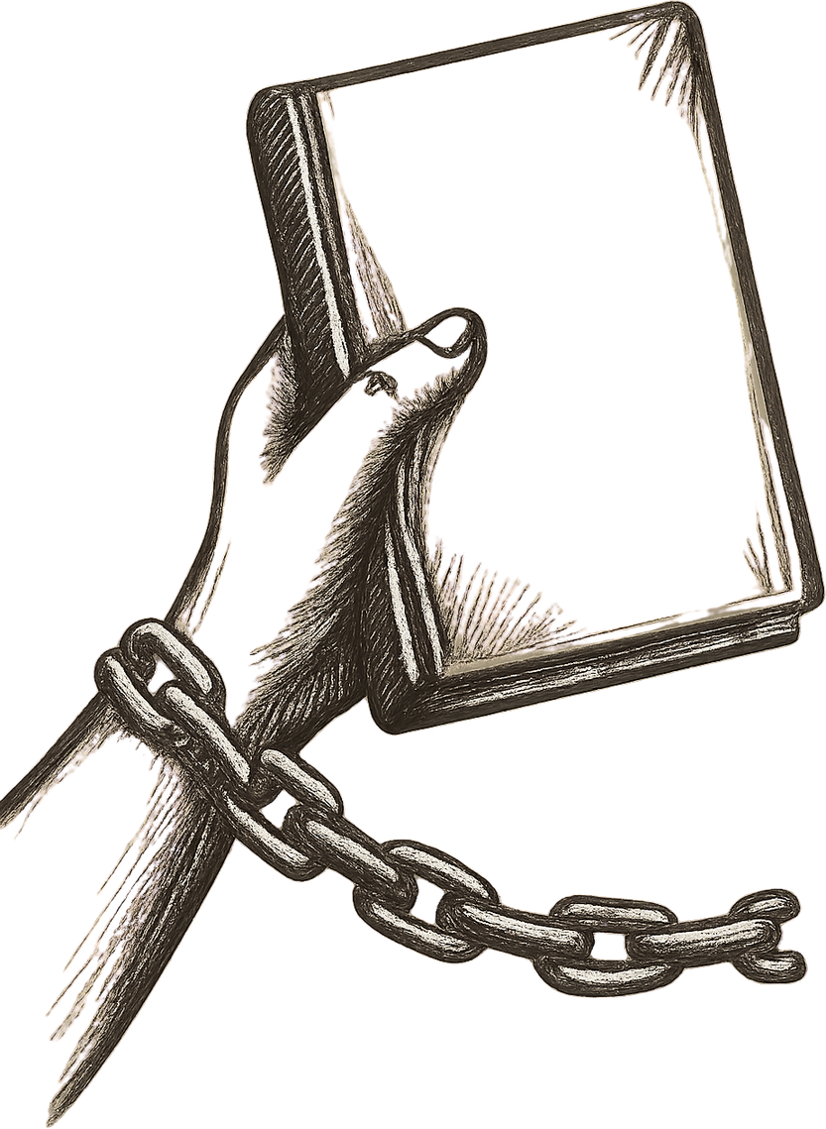
Why Do We Read It Then?
Since it is so likely that children will meet cruel enemies, let them at least have heard of brave knights and heroic courage.
C.S. Lewis

Slide 5
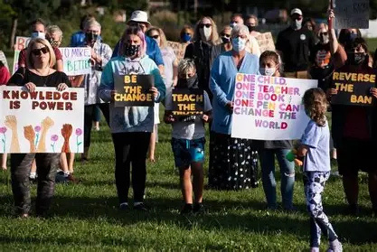
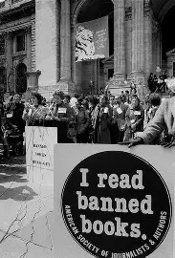



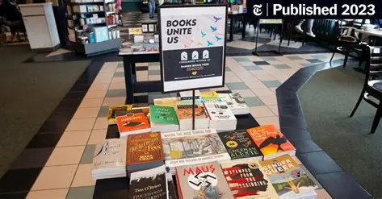

Slide 6

Thank You

Slide 7
Sources
Boissoneault, Lorraine. “A Brief History of Book Burning, From the Printing Press to Internet Archives.” Smithsonian Magazine, 31 Aug. 2017,
American Library Association – Banned & Challenged Books. Accessed 29 June 2026.
PEN America – Book Bans. Accessed 29 June 2026.
Adobe Stock. Adobe Stock Photos. Adobe, Accessed 29 June 2026.

